Slide 1

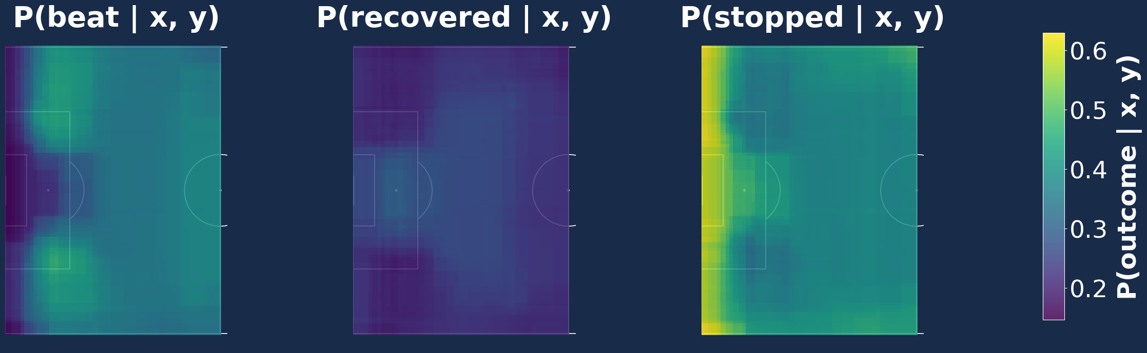

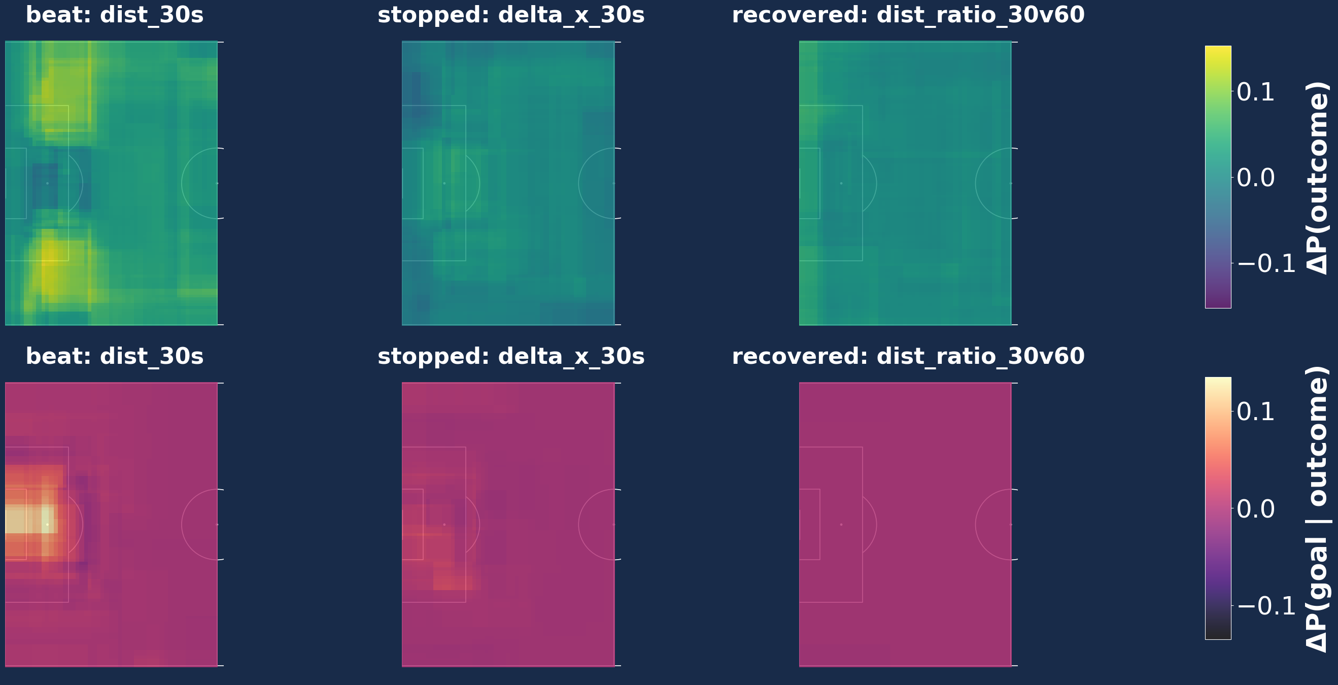
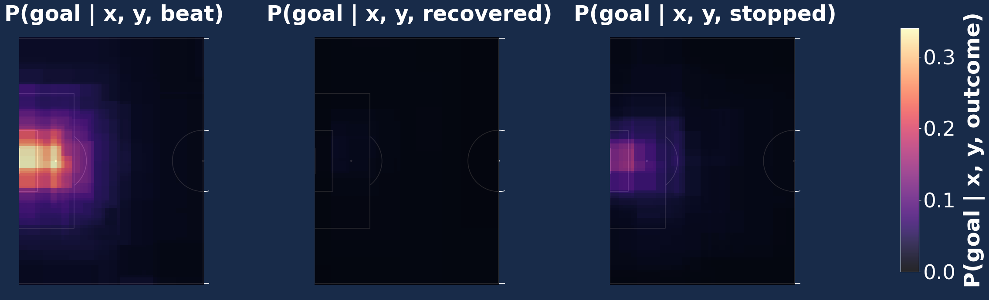
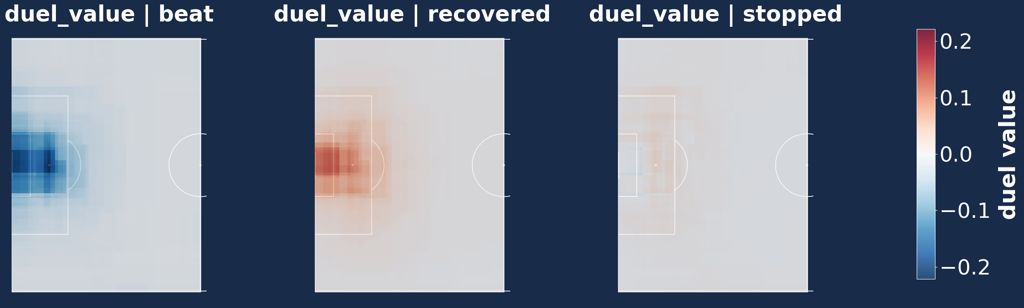
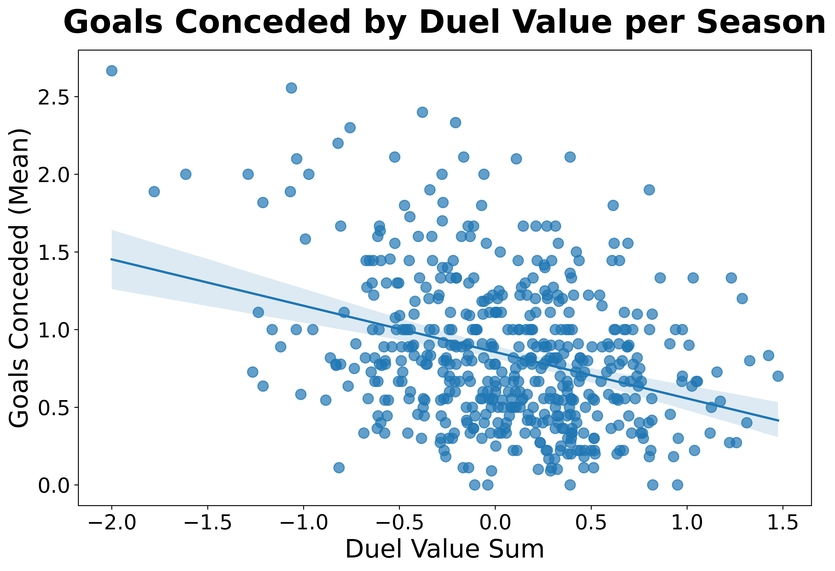
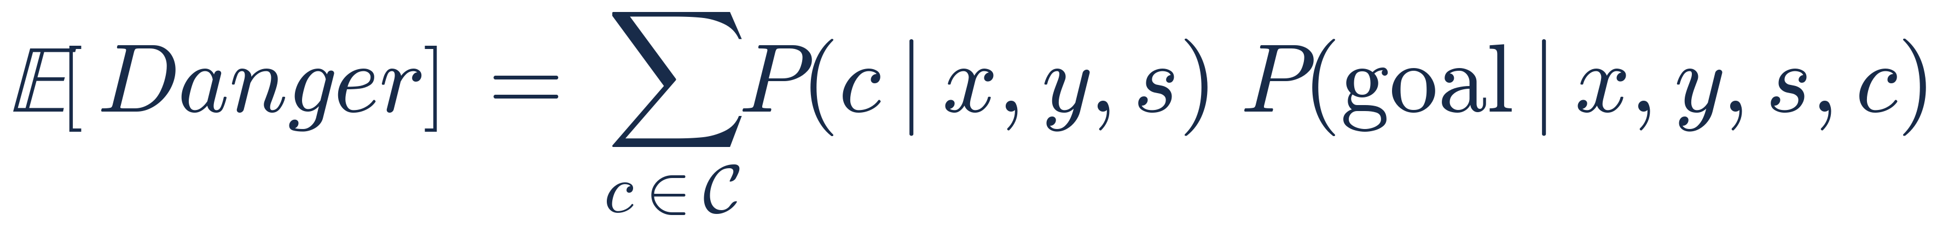
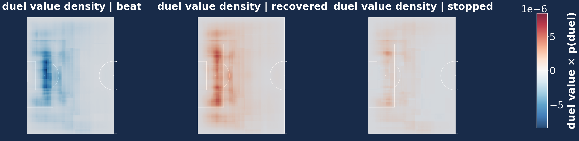
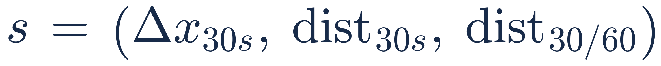

Valuing Defensive Duels in D1 Soccer
Cochran, Zach
https://github.com/zcochran27/HDSI-SCHOLARSHIP-PROJECT-SOCCER-DATA
Background:
Valuing actions in soccer is one of the hardest and most crucial parts for both game analysis and recruiting. Frameworks like xG (Probability of shot being scored), xT (Probability of scoring in next k actions), and VAEP (Change in probability of scoring) excel at modeling offensive contributions but struggle with defensive actions. Here, my work takes a counterfactual approach: measuring how a defender's action compares to the expected outcome.
Task:
From observed defensive duels, model defensive duel value as the expected danger minus the actual danger of the duel.
Model Inference:
Scan the QR code or visit the GitHub to
explore the model results in more depth.
Key Insights:
Duels at the corners of the 18 are significantly more difficult (~15%).
Losing duels in the box is extremely dangerous.
Total ball movement can affect difficulty by ~15% at the corners of the 18 and can affect danger by ~10% in the center of box.
A large negative displacement in x in past 30s increases p(recovered) in middle of box by ~4% but increases p(beat) at corners of 18 by ~2%.
Large difference in tempo between 30s an 60s increases P(recovered) by ~4%.
Performance Validation:
High duel value is significantly correlated with lower mean goals conceded across a season.
Duel value is a significantly better predictor of mean goals conceded than current defensive metrics.
Methods:
800k+ defensive duels across 7k+ D1 Wyscout matches.
Derived play outcome as a goal being conceded within 20 sec.
Engineered 3 speed of play features to capture context.
Ball Progression: Net displacement in x of the ball in past 30 sec.
Ball Tempo: Total distance the ball travelled in past 30 sec.
Change in Tempo: Ratio of ball travel distance in 30 sec over ball travel distance in 60 sec.
Trained two light gradient boosting models given the spatial and speed of play features.
First, to predict outcome of the duel (beat, stopped, recovered)
Second, to predict danger of the duel (goal conceded in 20s)
Defensive Duel Value (DDV) Definition
Where P(goal) is the probability of conceding a goal in the next 20 seconds and c is the outcome of the duel (beat, stopped, or recovered) and s are the speed of play features.
Predictor | R Squared
Sum Duel Value | .11
Mean Duel Value | .1
Recover Rate | .08
Stopped Count | .05
Recover Count | .01
Stop Rate | 0.0
DDV Density
From all 800k duels which actions have the most defensive duel value given the defenders outcome.
Conclusion:
Estimating defensive duel value as expected danger – observed danger gives us a wholistic view about a player’s / team’s defensive capabilities for analysis and recruiting purposes. We were also able to determine the factors that makes defensive duels difficult and dangerous.
datascience.ucsd.edu

